Slide 1
Healthcare Provider Fraud Detection
A Data Orbit project for detecting fraudulent healthcare providers

Slide 2
Problem Overview
-Fraudulent healthcare providers cost the U.S. Medicare system over $68 billion annually.
- Identifying fraudulent providers is critical to reducing these losses and maintaining the quality of healthcare services.

Slide 3
Project Objective
- Build a machine learning model to detect fraudulent healthcare providers using claims data.
- Ensure explainability and minimize false positives to avoid unnecessary investigations.
Goal:
To detect fraudulent providers and prioritize high-risk cases for CMS (Centers for Medicare and Medicaid Services).

Slide 4
Data Understanding
Datasets Used:
1. **Train_Beneficiarydata.csv**: Contains demographics, coverage, and chronic conditions for Medicare beneficiaries.
2. **Train_Inpatientdata.csv**: Hospital admission claims with financial, procedural, and physician details.
3. **Train_Outpatientdata.csv**: Outpatient claim data (visits, tests, minor procedures).
4. **Train_labels.csv**: Fraud labels (fraudulent or non-fraudulent) for healthcare providers.
Data Quality:
- Missing values were imputed.
- Inconsistent data entries (incorrect provider IDs) were cleaned and standardized.
- Datasets from different sources were merged, ensuring consistency in granularity and provider information.

Slide 5
Exploratory Data Analysis (EDA)
Key Insights from EDA:
• Imbalanced Data: Only around 10% of providers are fraudulent, which makes the problem harder.
• Fraud vs Non-Fraud Providers: Fraudulent providers show different behavior:
– Higher claim amounts
– More procedures per visit
– More claims overall
• Patterns Linked to Fraud: Certain behaviors (such as high costs and many procedures) were strongly linked to the likelihood of fraud.
Visuals:
- Fraud vs Non-Fraud Providers: Bar chart to show the distribution of fraudulent vs non-fraudulent providers.
- Claim Amount Distribution: Box plot to compare inpatient vs outpatient claims.
-Claims per Provider: Histogram showing the number of claims per provider.

Slide 6
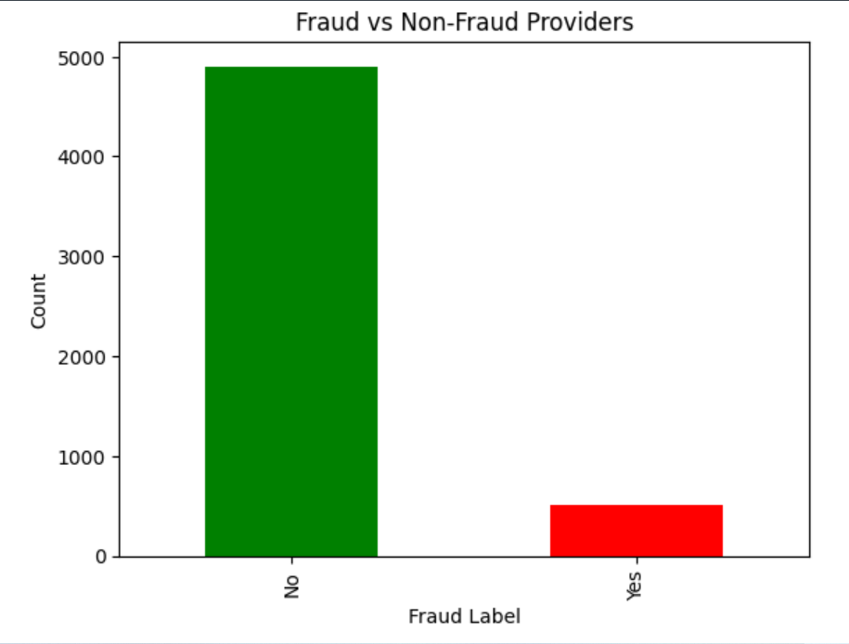
Fraud vs Non-Fraud Providers

Slide 7
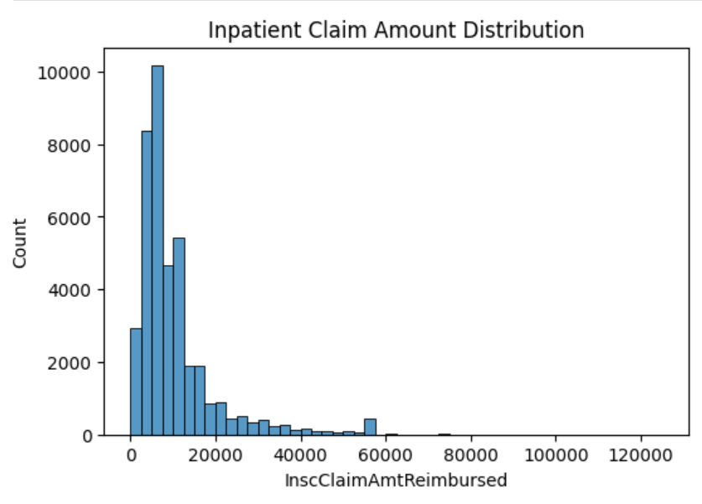
Claim Amount Distribution

Slide 8
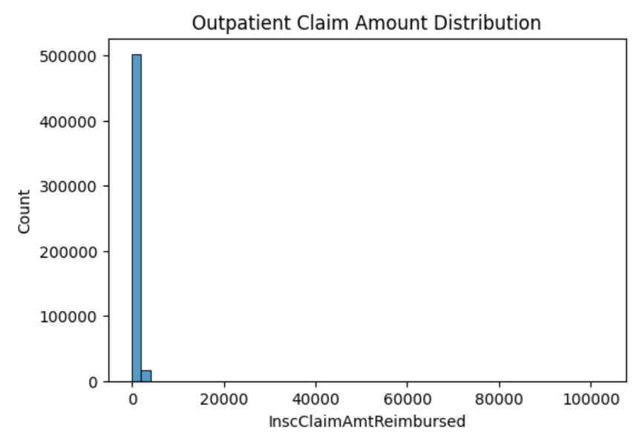
Claim Amount Distribution

Slide 9
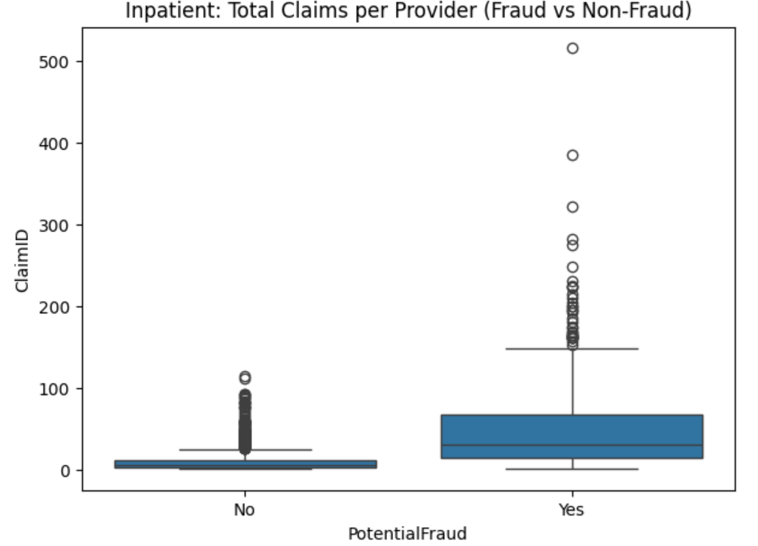
Claims per Provider

Slide 10
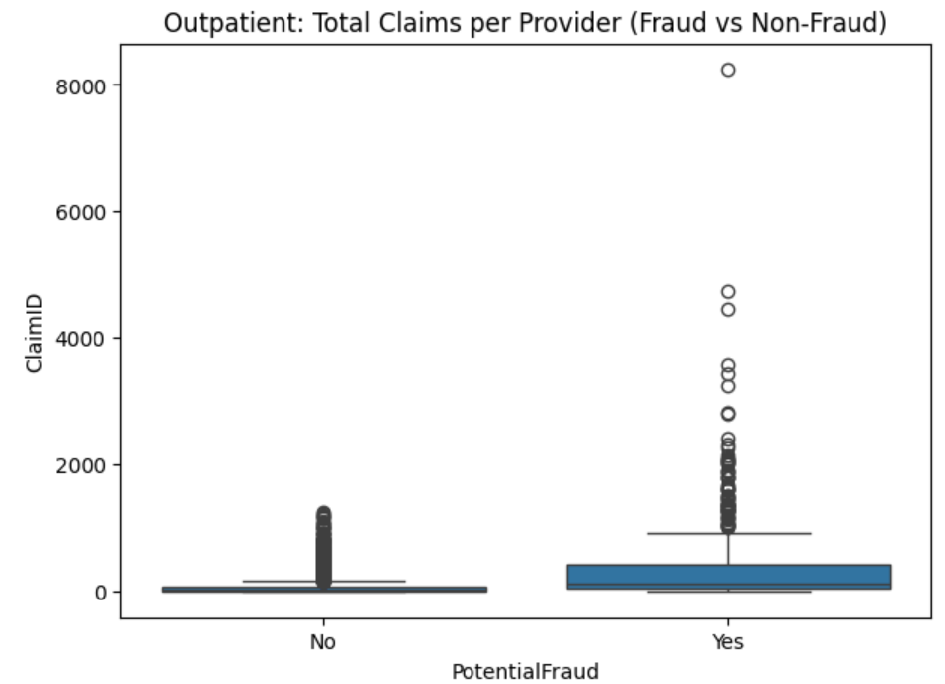
Claims per Provider

Slide 11
Feature Engineering
We created meaningful information about each provider to help the model learn better:
• Number of Procedures: How many medical procedures each provider typically performs.
• Total Claim Cost: How much money each provider bills Medicare.
• Beneficiary Information: Average patient age and number of chronic conditions.
• Claims Summary: How many total claims each provider submits.
Final Step:
We combined all inpatient, outpatient, and beneficiary information into one clean provider-level dataset.

Slide 12
Modeling
Models Tested:
- Decision Tree Classifier
- Logistic Regression
- Random Forest Classifier
- Gradient Boosting Classifier
- Support Vector Machine (SVM)
Class Imbalance Handling:
- Used **SMOTE** (Synthetic Minority Over-sampling Technique) to address class imbalance.
- Preprocessed data with **Standard Scaling** for numerical features and **One-Hot Encoding** for categorical features.
Best Model:
- Random Forest Classifier showed the best performance in identifying fraudulent providers with an **ROC AUC of 0.92** and **F1 Score of 0.59**.

Slide 13
Overall Methodology
1. Data Understanding
– Reviewed 4 datasets (beneficiary, inpatient, outpatient, labels)
– Identified key identifiers (BeneID, Provider)
2. Data Cleaning
– Handled missing values and inconsistent provider IDs
– Standardized formats across all datasets
3. Exploratory Data Analysis (EDA)
– Class imbalance analysis (10% fraud)
– Outlier detection
– Comparison between fraudulent and non-fraudulent providers
– Claim amount patterns (inpatient vs outpatient)
– Correlation and feature importance insights

Slide 14
4. Feature Engineering
– Aggregated claims per provider
– Computed claim costs, procedures, and beneficiary features
– Created final provider-level dataset
5. Modeling
– Trained Logistic Regression, Decision Tree, Random Forest, Gradient Boosting, SVM
– Applied SMOTE for imbalance
– Applied StandardScaling + OneHotEncoding
6. Evaluation
– Used Precision, Recall, F1 Score, PR AUC, ROC AUC
– Compared models and selected best-performing one
7. Error Analysis & Business Impact
– Analyzed financial impact of FP/FN
– Highlighted improvements for CMS

Slide 15
Evaluation
Evaluation Metrics:
- Precision: Proportion of true positives among all positive predictions.
- Recall: Proportion of true positives among all actual positives.
- F1 Score: Harmonic mean of Precision and Recall.
- PR AUC: Area under the Precision-Recall curve (important for imbalanced data).
- ROC AUC: Measures the ability of the model to distinguish between classes.
Best Model: Logistic Regression (highest ROC AUC and Precision).
Random Forest: Best balance between **Precision** and **Recall**, with **ROC AUC of 0.92**.

Slide 16
Model Comparison Results
LOGISTIC REGRESSION:
• Precision: 0.4583
• Recall: 0.8381
• F1 Score: 0.5925
• PR AUC: 0.6849
• ROC AUC: 0.9366 ← BEST OVERALL
GRADIENT BOOSTING:
• Precision: 0.4907
• Recall: 0.7619
• F1 Score: 0.5970
• PR AUC: 0.6265
• ROC AUC: 0.9167
RANDOM FOREST:
• Precision: 0.544
• Recall: 0.6476
• F1 Score: 0.5913
• PR AUC: 0.6125
• ROC AUC: 0.9231

Slide 17
Best Model Justification
BEST MODEL: Logistic Regression
Note: Logistic Regression achieved the highest ROC AUC and overall precision, while Random Forest achieved the best balance between precision and recall. Based on ROC AUC and interpretability, Logistic Regression is considered the best overall model.
WHY?
• Highest ROC AUC
• Strong Precision and Recall balance
• Highly interpretable for auditors
• Ideal for regulatory and compliance environments
Random Forest is also strong but slightly less interpretable.

Slide 18
Error Analysis
Error Analysis:
- False Positives: Legitimate providers flagged as fraudulent.
- Example: Providers PRV52296, PRV52318.
- Cost: $1,000 per false positive due to unnecessary investigations.
- False Negatives: Fraudulent providers missed by the model.
- Example: Providers PRV51378, PRV51480.
- **Cost**: $5,000 per false negative due to undetected fraud.
Financial Impact:
- Total **False Positive Cost**: $3,000
- Total **False Negative Cost**: $15,000
The significant cost of **false negatives** emphasizes the need to improve fraud detection.

Slide 19
Business Impact
Business Impact:
- Reduced Financial Losses: Prioritizing high-risk providers will help CMS focus resources on the most critical cases.
- Operational Efficiency: The model reduces unnecessary investigations by minimizing false positives.
- Fraud Prevention: The model helps detect fraudulent behavior early, saving significant costs for CMS.
The model can greatly enhance **fraud detection accuracy**, improving the quality and efficiency of Medicare’s fraud prevention efforts.

Slide 20
Conclusion
Summary:
- We built a machine learning model to detect fraudulent healthcare providers.
- The **Random Forest** model showed a good balance between **precision** and **recall**.
- **Logistic Regression** performed well in terms of **precision** and **ROC AUC**.
Future Work:
- Fine-tuning the models, optimizing hyperparameters, and adding new features (e.g., temporal/geographic data) to improve model performance.

